Slide 1

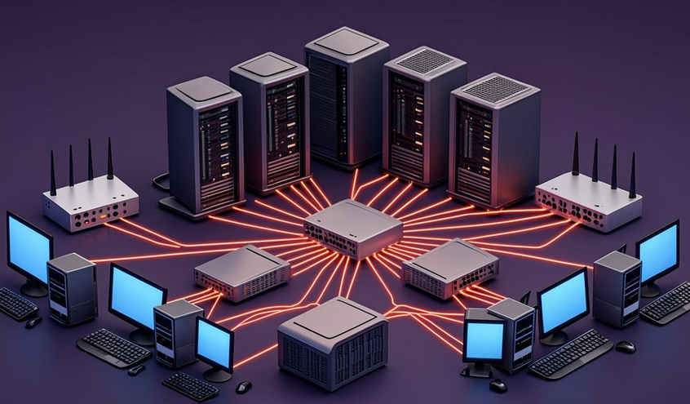


✦
UBUNTU INNOVATIONS (PTY) LTD
Design and Implementation of an IT
Infrastructure and Support Solution
IT Support Professional Certificate Capstone — Team Brain Sack Tech
S
Sinalo
M
Mbali
Project Manager & Business Analyst
Network Planner / Administrator
L
Luthando
M
Masibulele
Systems & Security Administrator
IT Support & Risk Manager
◔
10-minute project presentation
Notes:
• Welcome the panel and introduce Team Brain Sack Tech in one breath • Client: Ubuntu Innovations (Pty) Ltd, a fast-growing Cape Town start-up moving into a new office • Team of four: Sinalo, Mbali, Luthando, Masibulele — each owns one domain of the project • Preview: in the next 10 minutes we cover infrastructure, segmentation, security, support and risk

Slide 2
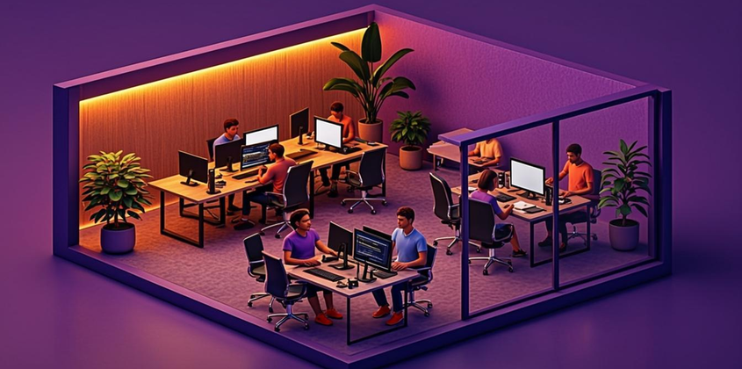
INTRODUCTION
Sinalo
Presented by
The business case
Ubuntu Innovations (Pty) Ltd
A fast-growing Cape Town tech start-up, relocating to a new office and in need of a fully documented IT infrastructure and support plan from day one.
25
6
employees, 5 departments
deliverables across 3 weeks
DEPARTMENTS
Executive Management
3
Finance
4
✓
What we were asked to design
Human Resources
3
Sales & Marketing
7
Secure wired & wireless connectivity, shared storage with access control
A real backup/recovery plan and protection against phishing & ransomware
Software Development
8
Documentation future IT staff can use — costed and presentable
BST
Brain Sack Tech — IT Infrastructure Capstone
2 / 10
Notes:
• Who the client is: Ubuntu Innovations, 25 people across 5 departments, relocating to a new Cape Town office • They need a fully documented IT infrastructure and support plan from day one • Our scope: 6 deliverables delivered in 3 weeks • The department roster sets up the permissions story on the next slide

Slide 3

FOUNDATIONS
Sinalo
Presented by
Requirements & access control
▤
Business Requirements Analysis
Connectivity, storage and printing for every department
Data classified Internal to Restricted, handled accordingly
Least privilege: access follows the job, not the person
POPIA obligations around personal information
6
19/19
“
Every department gets its own folder and group — Finance can’t see HR, Sales can’t see Development — tested and proven on a live Linux VM, not just drawn on paper.
security groups, one per department
permission tests passed in our Ubuntu lab
BST
Brain Sack Tech — IT Infrastructure Capstone
3 / 10
Notes:
• Requirements analysis: connectivity, storage and printing for every department • Least privilege — access follows the job, not the person • POPIA drives how personal information is classified and handled • Proof, not promises: 19/19 permission tests passed on a live Ubuntu VM — Finance can’t see HR, Sales can’t see Development

Slide 4
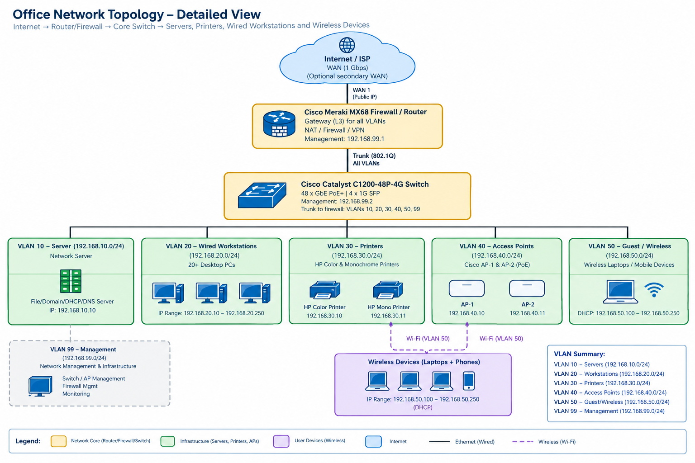
INFRASTRUCTURE
Mbali
Presented by
Hardware & network architecture
20 + 5
Desktops / laptops
1 + 1
Meraki firewall + 48-port switch
8 TB
Synology NAS (RAID 1)
✦
Why it’s built this way
6 VLANs: servers, users, printers, staff Wi-Fi, guest Wi-Fi, management
Guest Wi-Fi fully isolated from internal networks
LTE/5G failover keeps the office online if fibre drops
Built on our Week 1 topology, not redrawn from scratch
BST
Brain Sack Tech — IT Infrastructure Capstone
4 / 10
Notes:
• Walk the physical stack: 20 desktops + 5 laptops, Meraki firewall + 48-port switch, 8 TB Synology NAS in RAID 1 • Six VLANs segment servers, users, printers, staff Wi-Fi, guest Wi-Fi and management • Guest Wi-Fi is fully isolated from internal networks • LTE/5G failover keeps the office online if fibre drops • Topology comes straight from our Week 1 design, not redrawn

Slide 5
/24
SEGMENTATION
☻
Mbali
IP addressing & firewall rules
VLAN
PURPOSE
SUBNET
10
Servers
VLAN
192.168.10.0/24
VLAN
20
User devices
192.168.20.0/24
30
Printers
VLAN
192.168.30.0/24
VLAN
40
Staff Wi-Fi
192.168.40.0/24
VLAN
50
Guest Wi-Fi
192.168.50.0/24
VLAN
99
Management
192.168.99.0/24
Default–deny
12
32
every inbound connection is blocked unless explicitly allowed
documented firewall rules between networks
addressed devices, zero conflicts in our register
BST
Brain Sack Tech — IT Infrastructure Capstone
5 / 10
Notes:
• Six segments keep servers, users, printers, Wi-Fi and management apart — a breach in one can't roam • One clean /24 per VLAN makes the plan easy to read, document and firewall • Default–deny posture: 12 documented rules allow only what the business needs • 32 devices in the address register — zero conflicts during lab testing

Slide 6
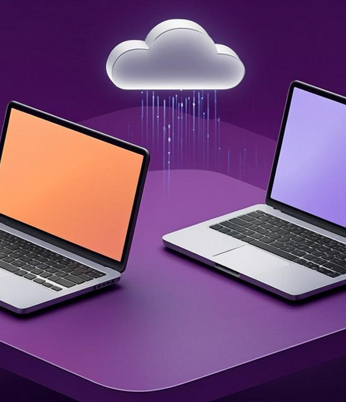
SOFTWARE
☻
Luthando
Two standard builds, centrally managed
▢
Windows office build
✦
Ubuntu developer build
17 devices
8 devices
Windows 11 Pro + Microsoft 365 Business Premium
Ubuntu 26.04 LTS, full-disk encrypted
One documented build script
Managed centrally with Microsoft Intune
ClamAV, UFW firewall, auto security updates
Defender for Business on every device
29
48h / 7d / 30d
0
products tracked in the Software Inventory
patch targets: critical / high / medium
licences bought without a documented need
BST
Brain Sack Tech — IT Infrastructure Capstone
6 / 10
Notes:
• Only two standard builds: a Windows 11 office stack and an Ubuntu LTS developer stack • Windows side: managed centrally with Intune, Defender for Business on all 17 devices • Developer side: one documented build script — any machine reproducible in minutes • Patch cadence: 48h critical / 7d high / 30d medium, tracked against the 29-product inventory • Zero licences bought without a documented need

Slide 7
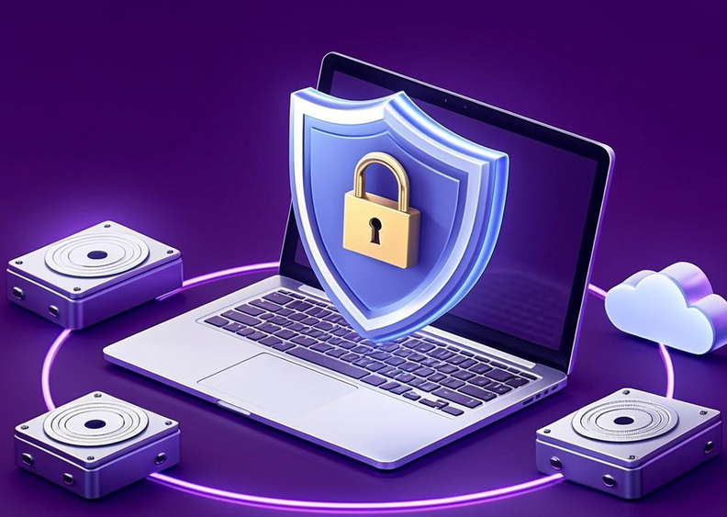
RESILIENCE & PROTECTION
☻
Luthando
Backup, recovery & cybersecurity
←
Backup: the 3-2-1 rule
3 copies of the data · 2 devices · 1 copy offsite — live NAS, a local backup drive, and an encrypted cloud copy.
4 hrs
1 hr
31
RTO: critical
RPO: snapshots
restore tests / yr
⛨
Cybersecurity policy highlights
12+ character passphrases, no forced 90-day resets — current NIST guidance
MFA required on every sign-in: email, VPN, admin consoles
Disk encryption + antivirus on every device, patched on a strict schedule
Defence in depth: 6 layers, from people and policy down to the data itself — no single control is ever trusted alone.
BST
Brain Sack Tech — IT Infrastructure Capstone
7 / 10
Notes:
• 3-2-1 in practice: live NAS + local backup drive + encrypted cloud copy • Recovery targets: 4-hour RTO for critical systems, 1-hour RPO via snapshots, 31 restore tests a year • Password policy follows current NIST guidance — 12+ character passphrases, no forced 90-day resets • MFA on every sign-in; disk encryption and antivirus on every device • Close on defence in depth: 6 layers, no single control trusted alone

Slide 8

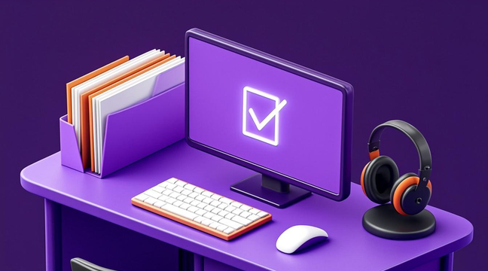
DAY-TO-DAY SUPPORT
☻
Masibulele
Shared folders, support & risk
⚠
Top risks identified
Risk
Likelihood
Impact
Phishing
High
High
Ransomware
Medium
High
Hardware failure
Medium
Medium
6 / 24
5
department folders / subfolders
documented troubleshooting cases
Power outage
Medium
High
Plus up to 7 more risks we added ourselves: stolen credentials, insider misuse, a lapsed licence, and more.
Folders match the Permissions Matrix exactly; each ticket records symptoms, causes, steps and resolution.
BST
Brain Sack Tech — IT Infrastructure Capstone
8 / 10
Notes:
• Folder tree mirrors the Permissions Matrix exactly — 6 department folders, 24 subfolders • 5 documented troubleshooting cases: every ticket logs symptoms, causes, steps and resolution • Walk the top risks: phishing high/high, ransomware medium/high, hardware failure, power outage • Mention the 7+ self-identified risks — stolen credentials, insider misuse, a lapsed licence

Slide 9


RESILIENCE
☻
Masibulele
Incident response & lessons learned
1
2
3
4
5
6
Detection
Reporting
Containment
Eradication
Recovery
Lessons learned
What this project taught us
01
02
03
Design and testing are different things
Every document has to agree with every other
Security is a system, not a checklist
Passwords, MFA, backups and segmentation only work together.
Our Ubuntu lab caught real gaps that looked fine on paper.
One VPN assumption had to be corrected across several files.
BST
Brain Sack Tech — IT Infrastructure Capstone
9 / 10
Notes:
• Run the six stages briskly: Detection → Reporting → Containment → Eradication → Recovery → Lessons learned • Stress the plan is documented before an incident, not improvised • Lesson 1: the Ubuntu lab caught real gaps that looked fine on paper • Lesson 2: one VPN assumption had to be corrected across several files • Lesson 3: security is a system — passwords, MFA, backups and segmentation work together

Slide 10


✦
UBUNTU INNOVATIONS (PTY) LTD
Thank you
Questions?
Sinalo · Mbali · Luthando · Masibulele
Team Brain Sack Tech — Ubuntu Innovations (Pty) Ltd IT Infrastructure Project
◔
10-minute project presentation
Notes:
• Thank the panel for their time and attention • Invite questions on any deliverable — network plan, policies, risk register, documentation • One-line reminder of the team: Sinalo, Mbali, Luthando, Masibulele • Close on the client scenario: Ubuntu Innovations' new office, ready from day one

